Slide 1


Introduction to GitHub
Prepared by
Tasnim Nishat Islam
Email: tislam3@umbc.edu
Graduate Teaching Assistant
Department of Computer Engineering
University of Maryland Baltimore County
Office hours: Mon-Wed 11:30PM-12:30PM
Tasnim Nishat Islam
Introduction to Github

Slide 2
Learning objectives
Git: Distributed Version Control System
Create a new repository in Github
Branching with Git
Push and pull requests
Tasnim Nishat Islam
Introduction to Github

Slide 3
Learning objectives
Git: Distributed Version Control System
Create a new repository in Github
Branching with Git
Push and pull requests
Tasnim Nishat Islam
Introduction to Github

Slide 4
Version Control System
What is a Version Control System?
Version control systems record changes to a file or set of files over time so that you can recall specific versions later
Example: RCS, CVS, Subversion, Git
Why use Version Control System?
Tracking changes
Short and long term undo
Backup and restore
Synchronization
Collaboration
Reference: https://people.cs.pitt.edu/~aus/cs1501/git_crash_course.pdf
Tasnim Nishat Islam
Introduction to Github

Slide 5
Version Control System
What is a Version Control System?
Version control systems record changes to a file or set of files over time so that you can recall specific versions later
Example: RCS, CVS, Subversion, Git
Why use Version Control System?
Tracking changes
Short and long term undo
Backup and restore
Synchronization
Collaboration
Reference: https://people.cs.pitt.edu/~aus/cs1501/git_crash_course.pdf
Tasnim Nishat Islam
Introduction to Github

Slide 6
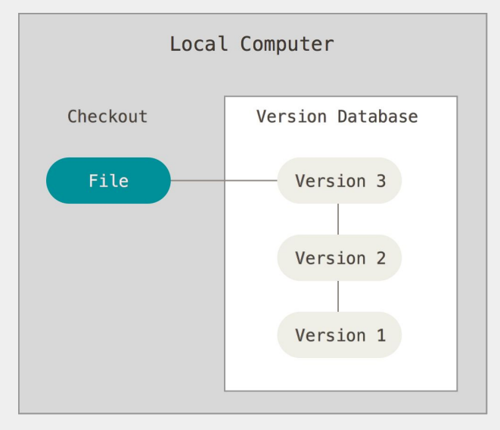
Local Version Control System
Reference: https://people.cs.pitt.edu/~aus/cs1501/git_crash_course.pdf
https://www.youtube.com/watch?v=HVsySz-h9r4&t=123s
Tasnim Nishat Islam
Introduction to Github

Slide 7
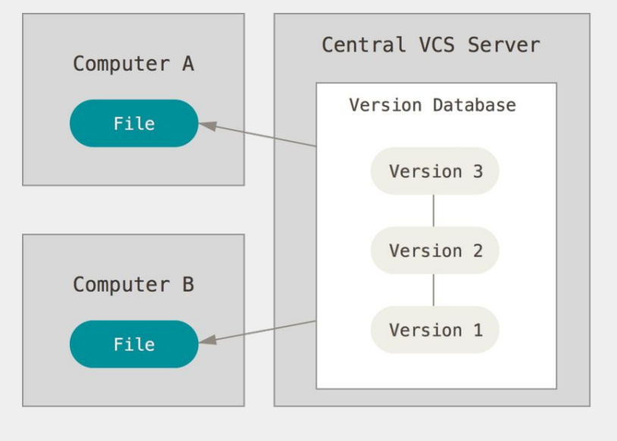
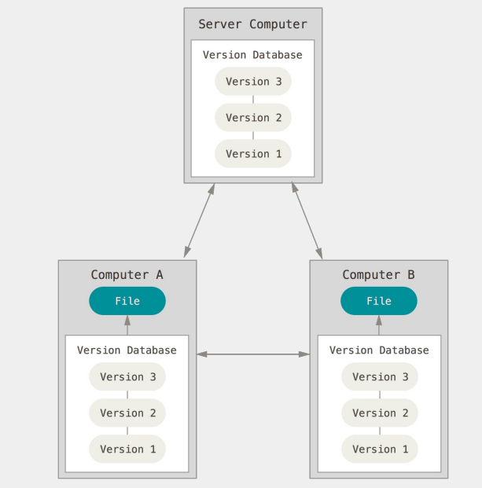
Types of version control systems
Centralized version control system
Distributed version control system
Reference: https://people.cs.pitt.edu/~aus/cs1501/git_crash_course.pdf
https://www.youtube.com/watch?v=HVsySz-h9r4&t=123s
Tasnim Nishat Islam
Introduction to Github

Slide 8
Distributed version control system
Every developer
has a backup of the remote repository
Can locally work on the project and put update request(push)
Can locally request updated version from central server (pull)
Reference: https://people.cs.pitt.edu/~aus/cs1501/git_crash_course.pdf
https://www.youtube.com/watch?v=HVsySz-h9r4&t=123s
Tasnim Nishat Islam
Introduction to Github

Slide 9
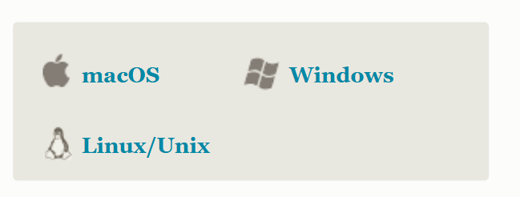
Install git
Go to https://git-scm.com/
Choose your operating system and download
Follow the instructions
Click ‘Launch with git bash’
Reference: https://www.youtube.com/watch?v=HVsySz-h9r4&t=123s
Tasnim Nishat Islam
Introduction to Github

Slide 10
Install git
Go to https://git-scm.com/
Choose your operating system and download
Follow the instructions
Click ‘Launch with git bash’
Go to your terminal and check
Reference: https://www.youtube.com/watch?v=HVsySz-h9r4&t=123s
Tasnim Nishat Islam
Introduction to Github

Slide 11
Git configure: Task 1
Globally configure your user name and user email id and check the configuration in list form in your local repository
https://git-scm.com/docs/git-config
Reference: https://www.youtube.com/watch?v=HVsySz-h9r4&t=123s
Tasnim Nishat Islam
Introduction to Github

Slide 12
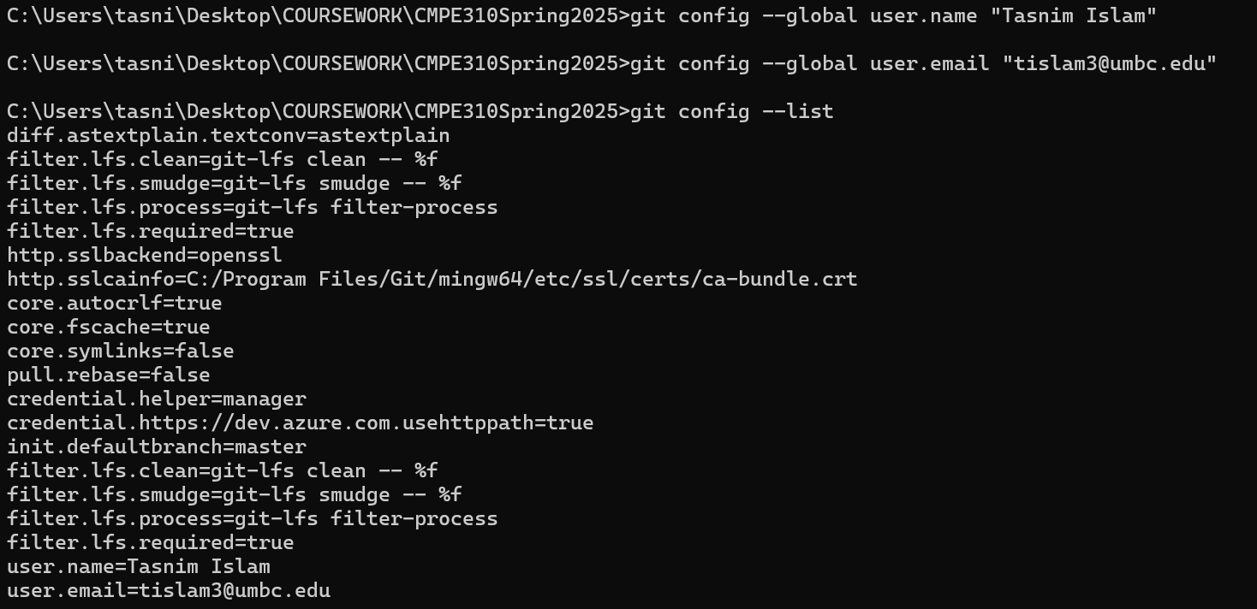
Git configure: Task 1: Solution
Reference: https://www.youtube.com/watch?v=HVsySz-h9r4&t=123s
Tasnim Nishat Islam
Introduction to Github

Slide 13
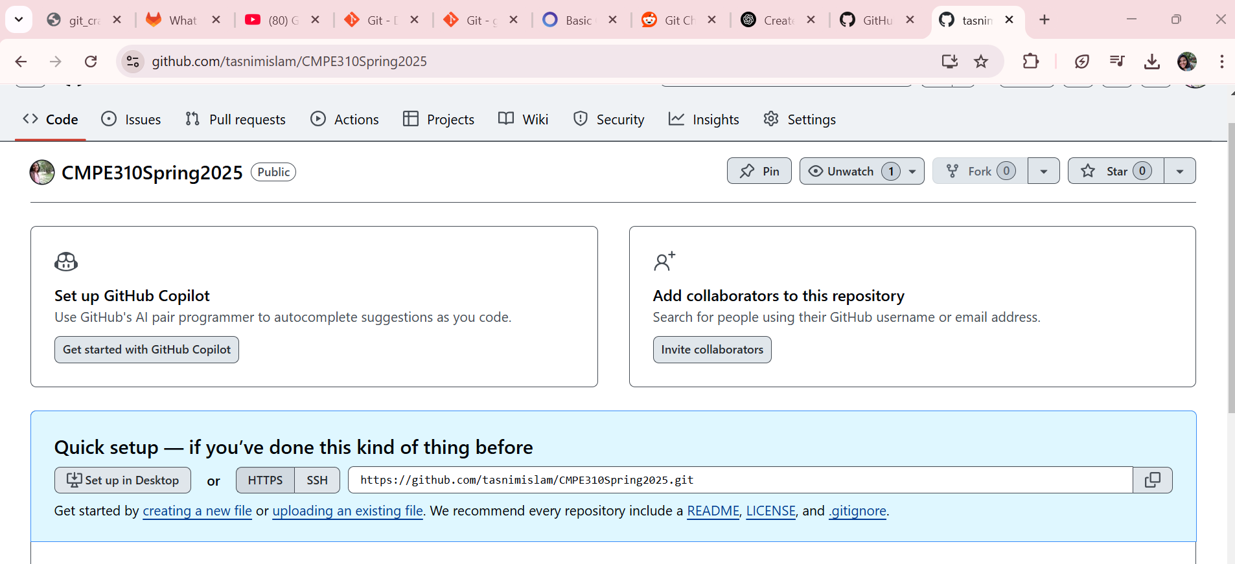
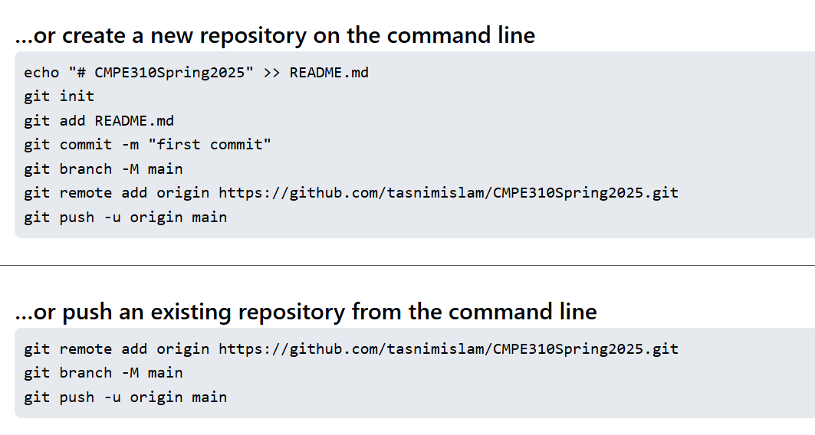
Git configure: Task: 2
Setup new git repository
Tasnim Nishat Islam
Introduction to Github

Slide 14
Task 2
Create a text file
Push to the github repository you have created
https://github.com/tasnimislam/CMPE310Spring2025
Tasnim Nishat Islam
Introduction to Github

Slide 15
Task 3
Make a new branch named “newBranch” via command line and update the github repository with the message “New Branch”
Tasnim Nishat Islam
Introduction to Github

